Slide 1


Slide 2
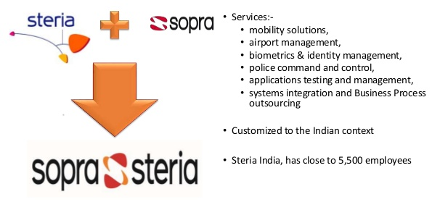
ABOUT THE COMPANY
Sopra Steria, a European leader in digital transformation, provides one of the most comprehensive portfolios of end-to-end service offerings on the market: consulting, systems integration, software development, infrastructure management and business process services.

Slide 3
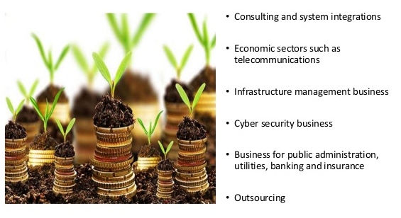
Sources of Revenue Generation

Slide 4
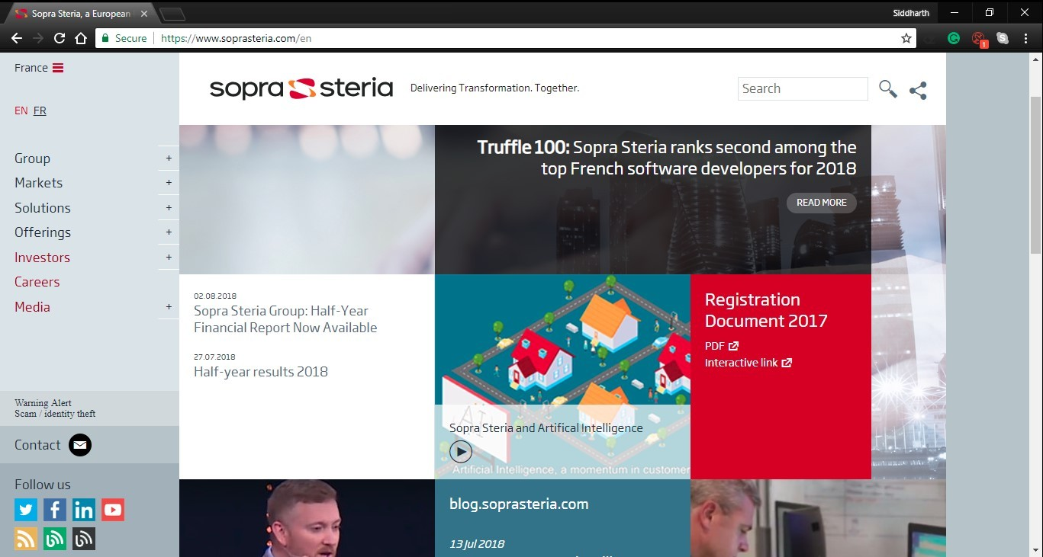
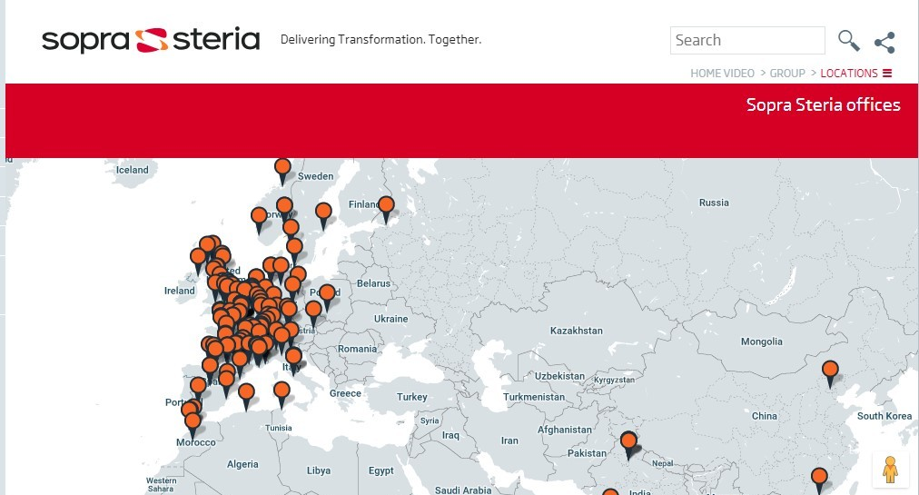
Company Website and Locations

Slide 5
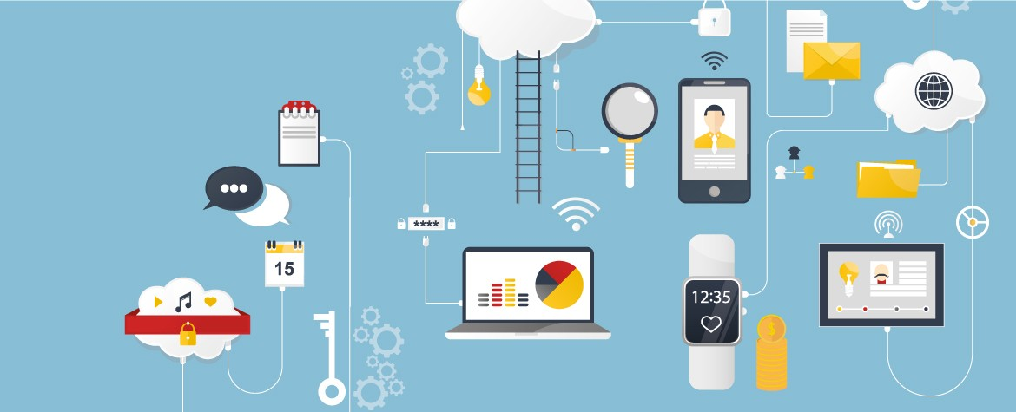
INTERNSHIP DISCRIPTION
The aim of the training is to make the trainee familiar with the Cloud Computing and the various Cloud services used in the industry.
Simply put, cloud computing is the delivery of computing services—servers, storage, databases, networking, software, analytics and more—over the Internet (“the cloud”). Companies offering these computing services are called cloud providers and typically charge for cloud computing services based on usage, similar to how you are billed for water or electricity at home.

Slide 6
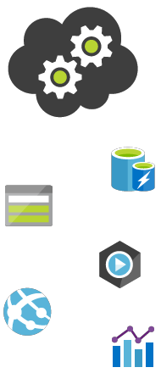
USES OF CLOUD COMPUTING
You are probably using cloud computing right now, even if you don’t realize it. If you use an online service to send email, edit documents, watch movies or TV, listen to music, play games or store pictures and other files, it is likely that cloud computing is making it all possible behind the scenes. The first cloud computing services are barely a decade old, but already a variety of organizations—from tiny start-ups to global corporations, government agencies to non-profits—are embracing the technology for all sorts of reasons. Here are a few of the things you can do with the cloud:
• Create new apps and services
• Store, back up and recover data
• Host websites and blogs
• Stream audio and video
• Deliver software on demand
• Analyze data for patterns and make predictions

Slide 7

Types of cloud services: IaaS, PaaS, SaaS
Most cloud computing services fall into three broad categories: infrastructure as a service (IaaS), platform as a service (PaaS) and software as a service (SaaS). These are sometimes called the cloud computing stack, because they build on top of one another. Knowing what they are and how they are different makes it easier to accomplish your business goals.
Infrastructure-as-a-service (IaaS)
The most basic category of cloud computing services. With IaaS, you rent IT infrastructure—servers and virtual machines (VMs), storage, networks, operating systems—from a cloud provider on a pay-as-you-go basis.
Platform as a service (PaaS)
Platform-as-a-service (PaaS) refers to cloud computing services that supply an on-demand environment for developing, testing, delivering and managing software applications. PaaS is designed to make it easier for developers to quickly create web or mobile apps, without worrying about setting up or managing the underlying infrastructure of servers, storage, network and databases needed for development.
Software as a service (SaaS)
Software-as-a-service (SaaS) is a method for delivering software applications over the
Internet, on demand and typically on a subscription basis. With SaaS, cloud providers host and manage the software application and underlying infrastructure and handle any maintenance, like software upgrades and security patching. Users connect to the application over the
Internet, usually with a web browser on their phone, tablet or PC.
TYPES OF CLOUD COMPUTING

Slide 8
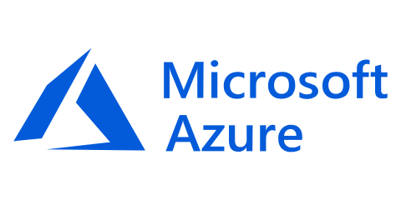
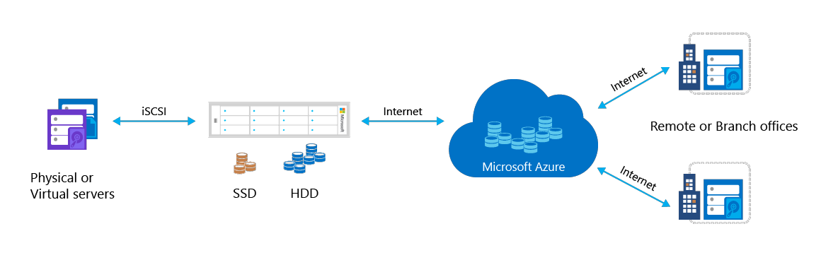
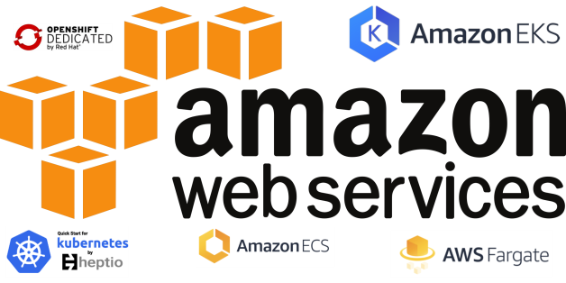
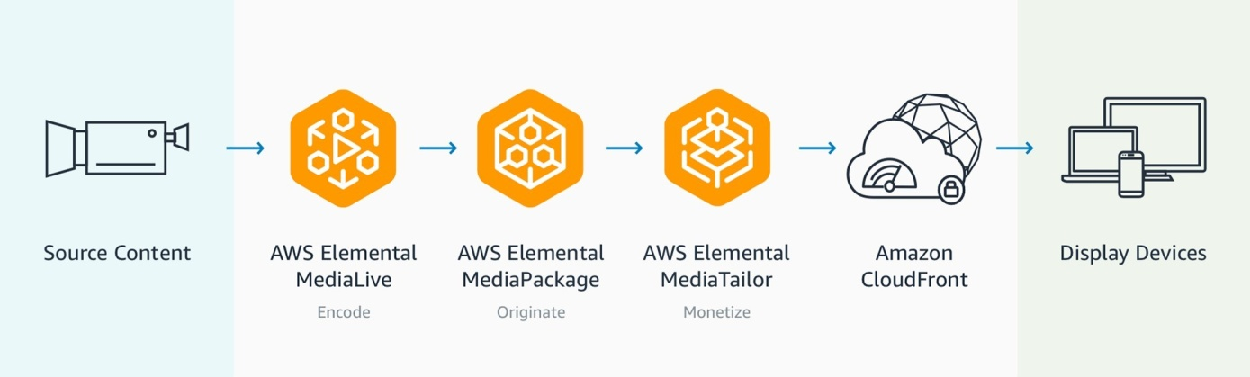
MAJOR CLOUD SERVICE PROVIDERS

Slide 9
THANK YOU

